Slide 1

Lab 08
FIT5202 Big Data Processing
K-Means Clustering
Model Selection

Slide 2
Lab 7 Agenda
•
Part - A
•
Part - B
•
Session 06 Review
•
Model Selection
•
Hyperparameter Tuning
•
K-means Clustering
•
Cross Validation
•
Silhouette Score
•
K-fold Cross Validation
•
TrainValidationSplit
•
Lab Instructions
•
Model Persistence
•
Use case : Identify if 3
•
Saving and Loading a Model
hackers were involved

Slide 3
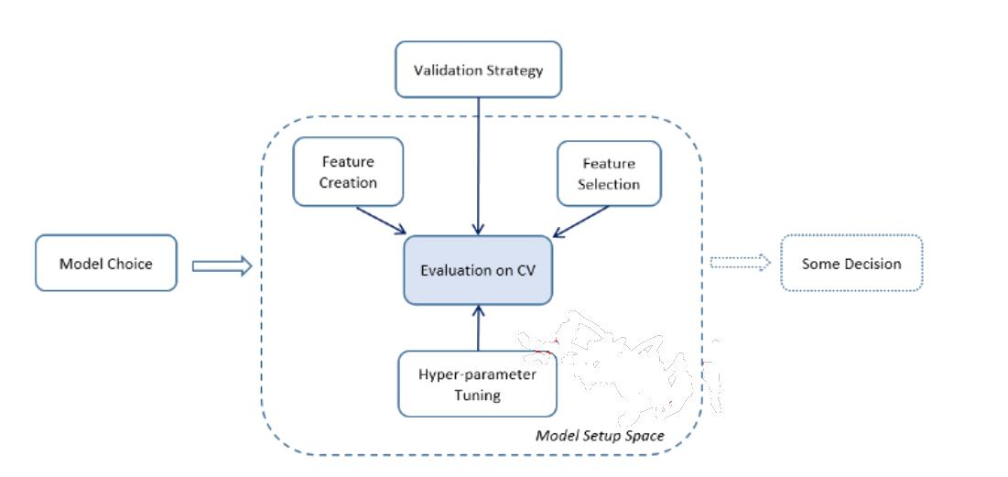
Model Selection
All models are wrong; some are useful (George E.P. Box)
•
HyperParameter Tuning
•
Finding the best model or parameters
•
Tuning can be done for individual Estimators or the
entire Pipeline
Model selection for Mlib has the following tools:
1.
CrossValidator
2.
TrainValidationSplit
https://spark.apache.org/docs/latest/ml-tuning.html
https://towardsdatascience.com/hyperparameter-tuning-explained-d0ebb2ba1d35

Slide 4
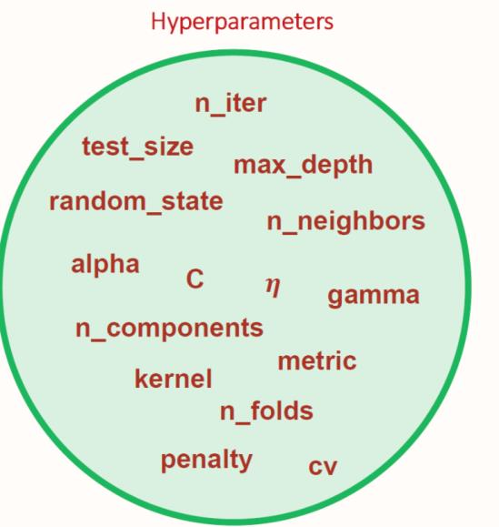
Hyperparameter Tuning
•
Hyper-parameters are not model parameters :
they cannot be trained from the data
•
Hyperparameter tuning : choosing a set of
optimal hyperparameters for a learning algorithm
•
model.getParamMap() to get the list of
hyperparameters for the model
https://towardsdatascience.com/model-parameters-and-hyperparameters-in-machine-learning-what-is-the-difference-702d30970f6

Slide 5
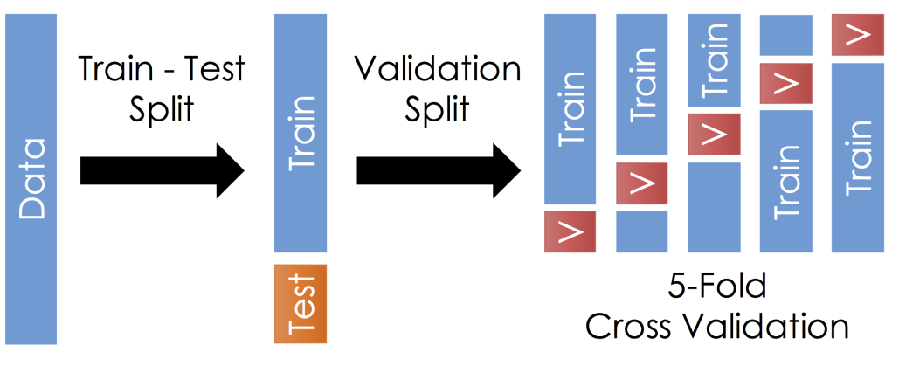
Cross Validation (K-Fold)
- Splitting dataset into a set of folds, which are used as separate training and test datasets.
http://www.ds100.org/sp17/assets/notebooks/linear_regression/Cross_Validation_and_the_Bias_Variance_Tradeoff.html

Slide 6
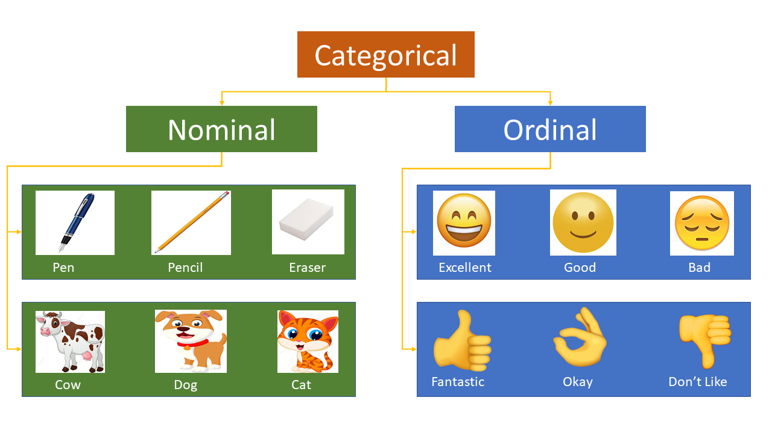
Categorical features
Categorical variables represent types of data which may be divided into groups.
No ordering
The variables have natural,
ordered categories

Slide 7
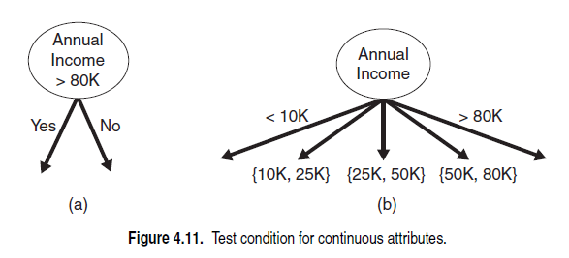
Hyperparameter: maxBins
Example
Consider variable
[1,3,4,6,2,5,18,10,-3,-5]
Continuous features
X with instances
We can sort data, and cluster data into bins to
choose splitting point (e.g., -1,2.5,4.5, and 8)
[-5,-3,1,2,3,4,5,6,10,18]
[-5,-3],[1,2],[3,4],[5,6],[10,18]
❑ The test condition can be expressed as a
Maximum number of bins can be
comparison test (
𝐴 < 𝑣
) and (
𝐴 > 𝑣
) with
specified using maxBins.
binary outcome, or a range of a range of
outcomes
𝑣
< 𝐴 < 𝑣
for i=1,…, k
𝑖
𝑖+1
❑ For binary tree, algorithm will consider all
split position v (splitting point / threshold)
https://spark.apache.org/docs/1.1.0/mllib-decision-tree.html
https://www-users.cs.umn.edu/~kumar001/dmbook/ch4.pdf

Slide 8
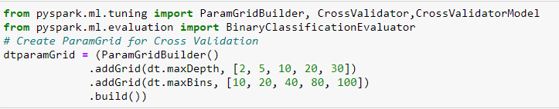

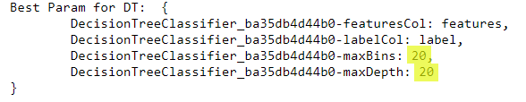
Cross Validation (Decision Tree)

Slide 9
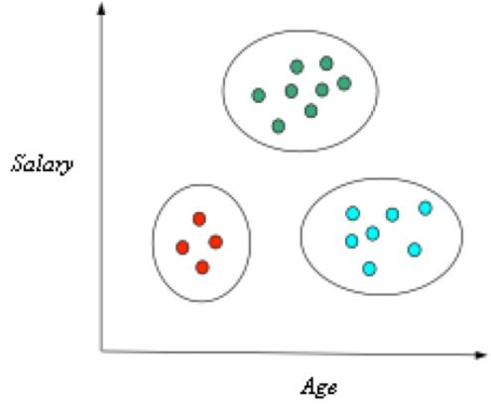
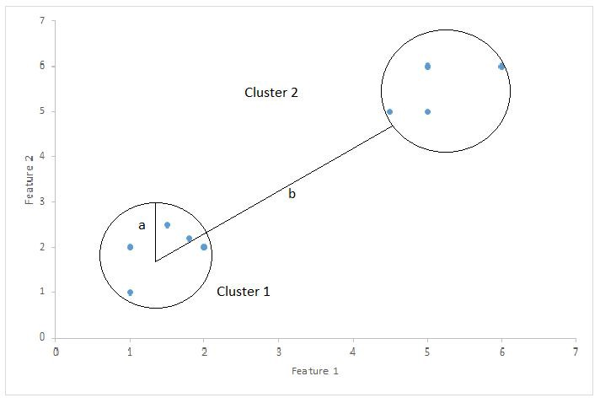

K-Means Clustering
Finds groups (or clusters) of data
A cluster comprises a number of “similar” objects
A member is closer to another member within the same group than to a member of a different group
Groups have no category or label
Unsupervised learning
Animation Demo
Animation Demo 2
Silhouette Score [-1 1] :
calculates the goodness of a clustering technique
•
1 - Clusters are well apart from each other and clearly distinguishes
•
0 - Clusters are not clearly distinguished, the distance between the clusters is
not significant (overlapping cluster)
•
-1 – Clusters assigned wrongly
https://towardsdatascience.com/silhouette-coefficient-validating-clustering-techniques-e976bb81d10c
a= average intra-cluster distance
b= average inter-cluster distance

Slide 10
Use case : Was there a third hacker?
Assumption : Hackers trade off attacks equally
K-means
3-clusters
Hack Data
K=3
no of instances
predictions
in each cluster
Was there a third
2-clusters
hacker?
K=2
??

Slide 11
Thank You!
See you next week.

